Slide 1




KIET GROUP OF INSTITUTIONS
MLSA KIET INTERNSHIP
TO DO WEB APP
DOMAIN: FULL STACK WEB DEVELOPMENT
Name- Kumari Chetana
Department-Computer Science
University Roll no.- 2200290120093

Slide 2

PROBLEM STATEMENT
Develop a web-based to-do list application using JavaScript that enables users to efficiently manage their tasks by allowing them to add new tasks and remove completed or unwanted tasks. The application should offer a simple and intuitive interface for task management to improve productivity.

Slide 3
SOLUTION
User Interface Design:Create a responsive UI using HTML and CSS, including an input field for adding tasks, a submit button, and a list display area with options for task removal.
JavaScript Functionality: Implement JavaScript to dynamically manage tasks, using event listeners to add and remove tasks, and store tasks in an array for in-memory management.
01

Slide 4
TECH STACK
REACT JS
NODE JS

Slide 5
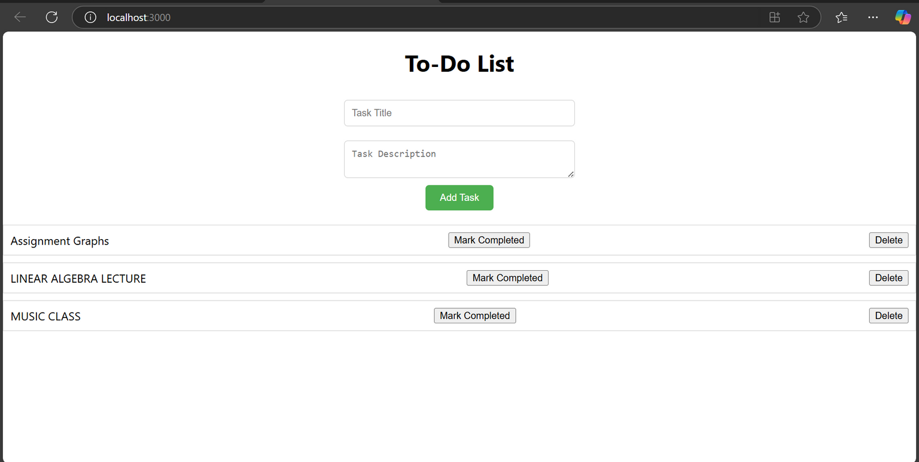
PROJECT OVERVIEW
TASK CREATION

Slide 6
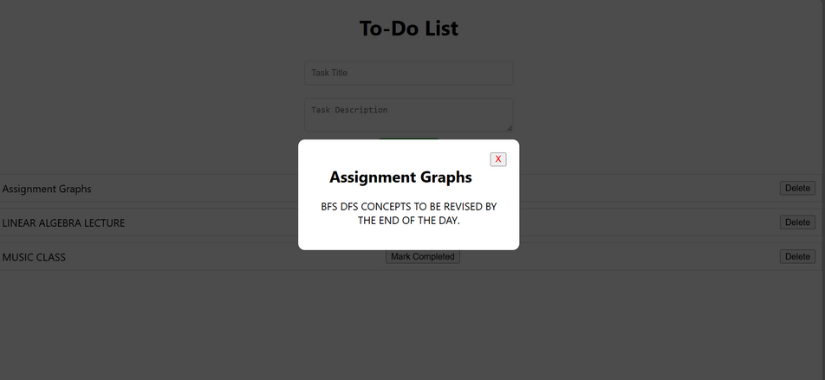
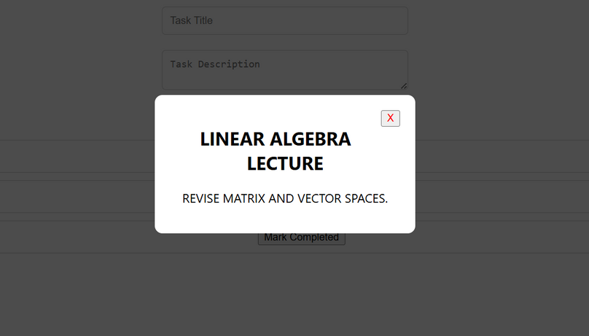
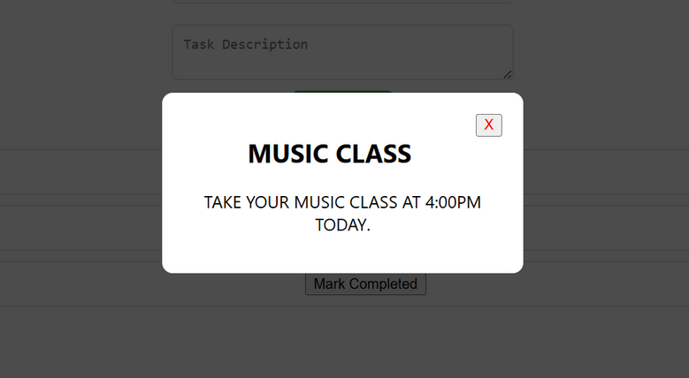
PROJECT OVERVIEW
2. TASK DESCRIPTION

Slide 7
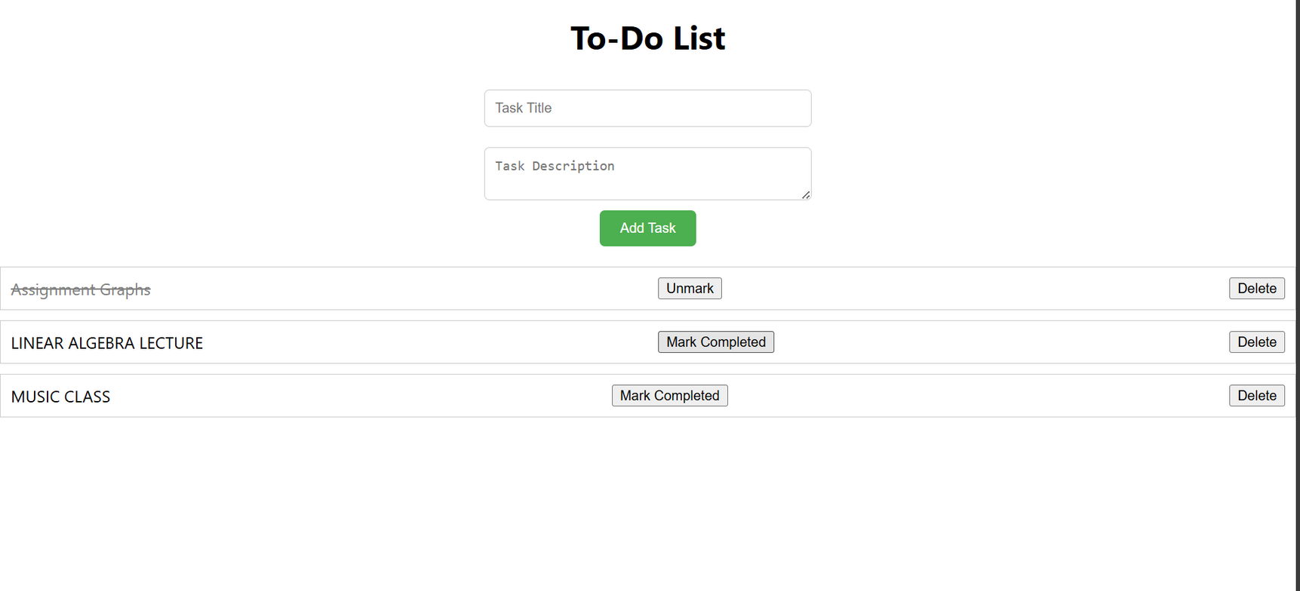
PROJECT OVERVIEW
3. TASK COMPLETION

Slide 8
THANK YOU

